Slide 1
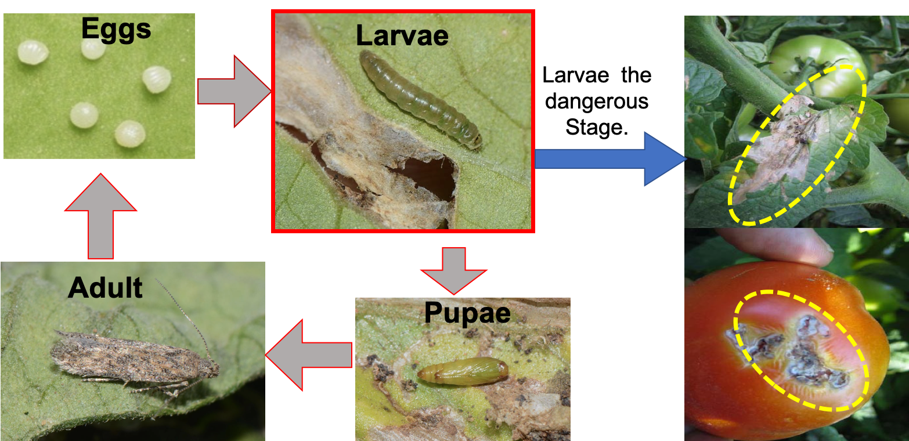
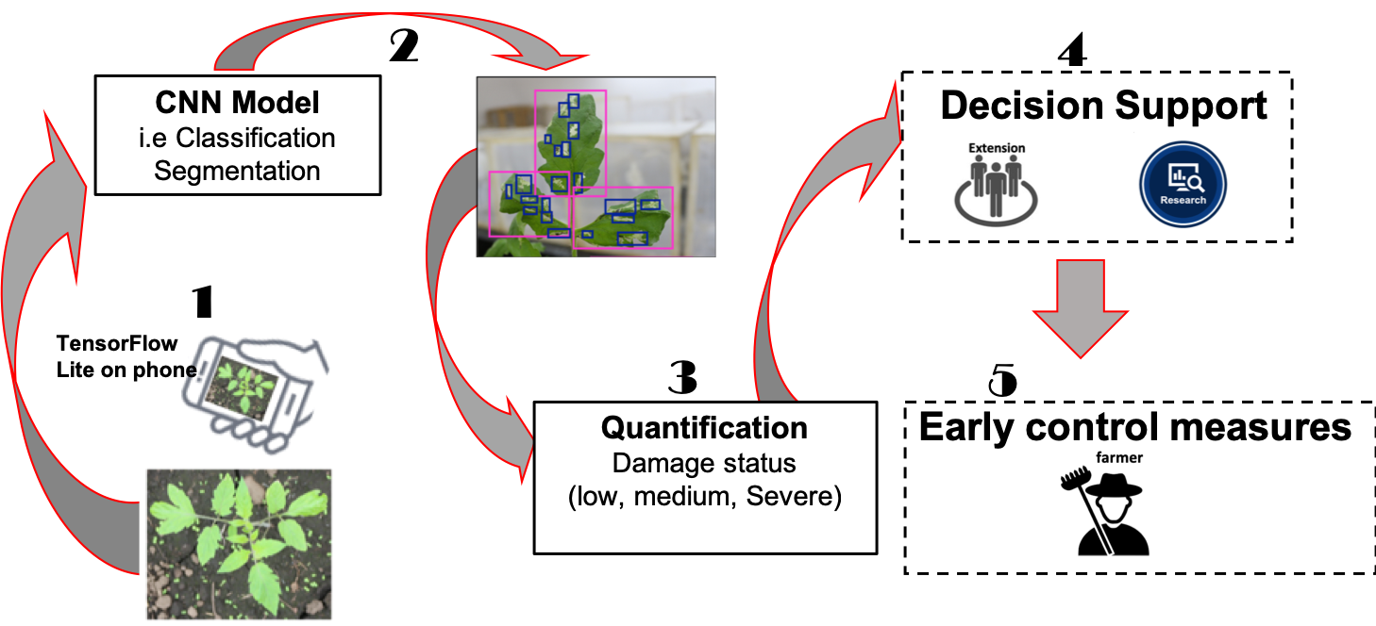
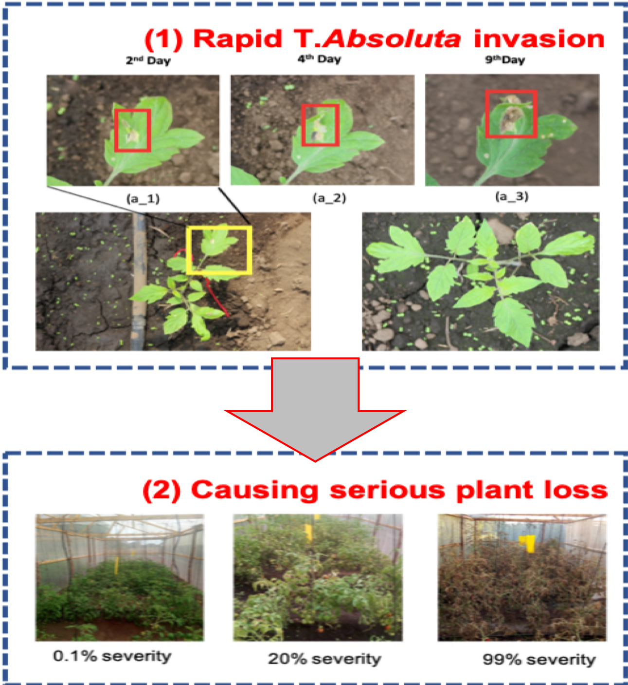
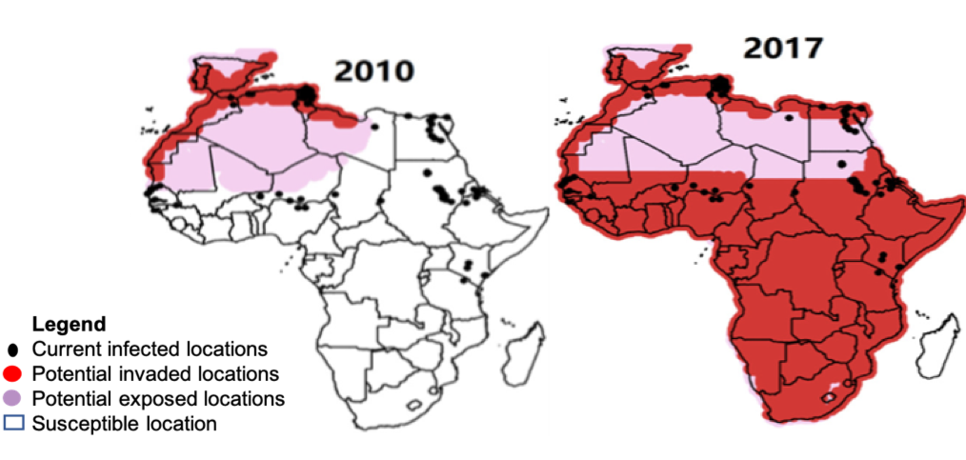
A Computer Vision Tomato Pest Assessment and Prediction Tool Denis. P. Rubanga¹, L. Mkonyi², R. Mgaya³, N. Zekaya², S.Shimada¹, D. Machuve² ¹Tokyo University of Agriculture, Tokyo-Japan, ²The Nelson Mandela African Institute of Science and Technology, Arusha-Tanzania, ³Sokoine University of Agriculture,Morogoro-Tanzania :denispastoty@gmail.com
Tokyo University of Agriculture
Sokoine University of Agriculture
The Nelson Mandel African Institute of Science and Technology
CV4GC Workshop
Background
Tomato considered a high value crop and income resource for poor growers (FAO, 2012)
But Tuta absoluta is devastating tomato yield causing loss of up to 100% jeopardizing livelihoods of millions
Important to understand crop stress for crop production
(food security and poverty alleviation) (Smucker et al, 2015)
Current strategy
High cost pesticide use
Development of resistant tomato varieties
Application of biological control
Pheromone traps for monitoring population
and presence detection
Also limited number of agriculture extension officers service
Solution
Using Computer Vision:
For top 20 tomato producers in Africa
a 50% loss (10000 KT) reduction would save $7 Billion
Above are low-speed
inefficient manual identification
Therefore, A fast Early detection Computer
Vision solution for T.absoluta case is required
4078 images collected
Tomato plant images of early growth stage
Why it matters?
Emergency state of Tuta absoluta
In less than 10 years
Tuta absoluta had been reported in almost
all African countries
Limitations:
Image data was collected from Arusha region –Tanzania. More data from other regions of Tanzania and Sub-Sahara Africa is required.
More data will be added to database through developed mobile App.
Future work
We would extend the system to other invasive crop pests.
Collected multispectral images will be used to develop Vegetation indices for Tuta absoluta invaded crop farms.
Reference:
[1] FAOSTAT (2012)
[2] Guimapi, R. Y., Mohamed, S. A., Okeyo, G. O., Ndjomatchoua, F. T., Ekesi, S., & Tonnang, H. E. (2016). Modeling the risk of Invasion and spread of Tuta absoluta in Africa. Ecological complexity, 28, 77-93.
[3] He, K., Gkioxari, G., Dollár, P., & Girshick, R. (2017). Mask r-cnn. In Proceedings of the IEEE international conference on computer vision (pp. 2961-2969).
[4]Krizhevsky, A., Sutskever, I., Hinton. G.: ImageNet classification with deep convolutional neural networks. In: Advances in Neural Information Processing Systems, vol. 25, pp. 1097– 1105 (2012)
[5]Smucker, Thomas A., et al. "Differentiated livelihoods, local institutions, and the adaptation imperative: Assessing climate change adaptation policy in Tanzania." Geoforum 59 (2015): 39-50..
CLIMEX climatic suitability indices for Tuta. absoluta in Africa. Predictions are based on the eco-climatic index (EI). Source; Henri et al.,(2015)

